Slide 1
Common Core Shifts in English Language Arts
Implications for Instruction, Assessment and Leadership!
Presented By:
Sheryl White
Educator Leader Cadre- ELA Chair

Slide 2
Session Goals
Learn about the key features and differences of the ELA/Literacy Common Core Standards.
Gain awareness of the shifts in the ELA/Literacy standards and implications for instruction, assessment and leadership.

Slide 3
Students Who are College and Career Ready
In Reading, Writing, Speaking, listening and Language
Demonstrate independence.
Build strong content knowledge.
Respond to the varying demands of audience, task, purpose, and discipline.
Comprehend as well as critique.
Value evidence.
Use technology and digital media strategically and capably.
Come to understand other perspectives and cultures.

Slide 4
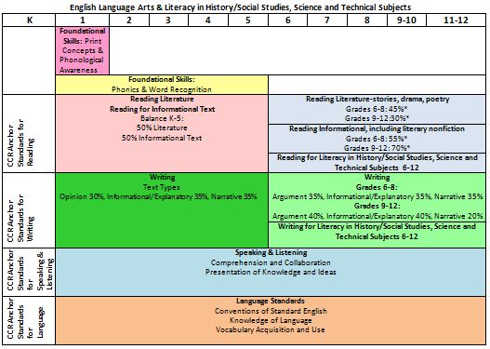
Common Core English Language Arts

Slide 5
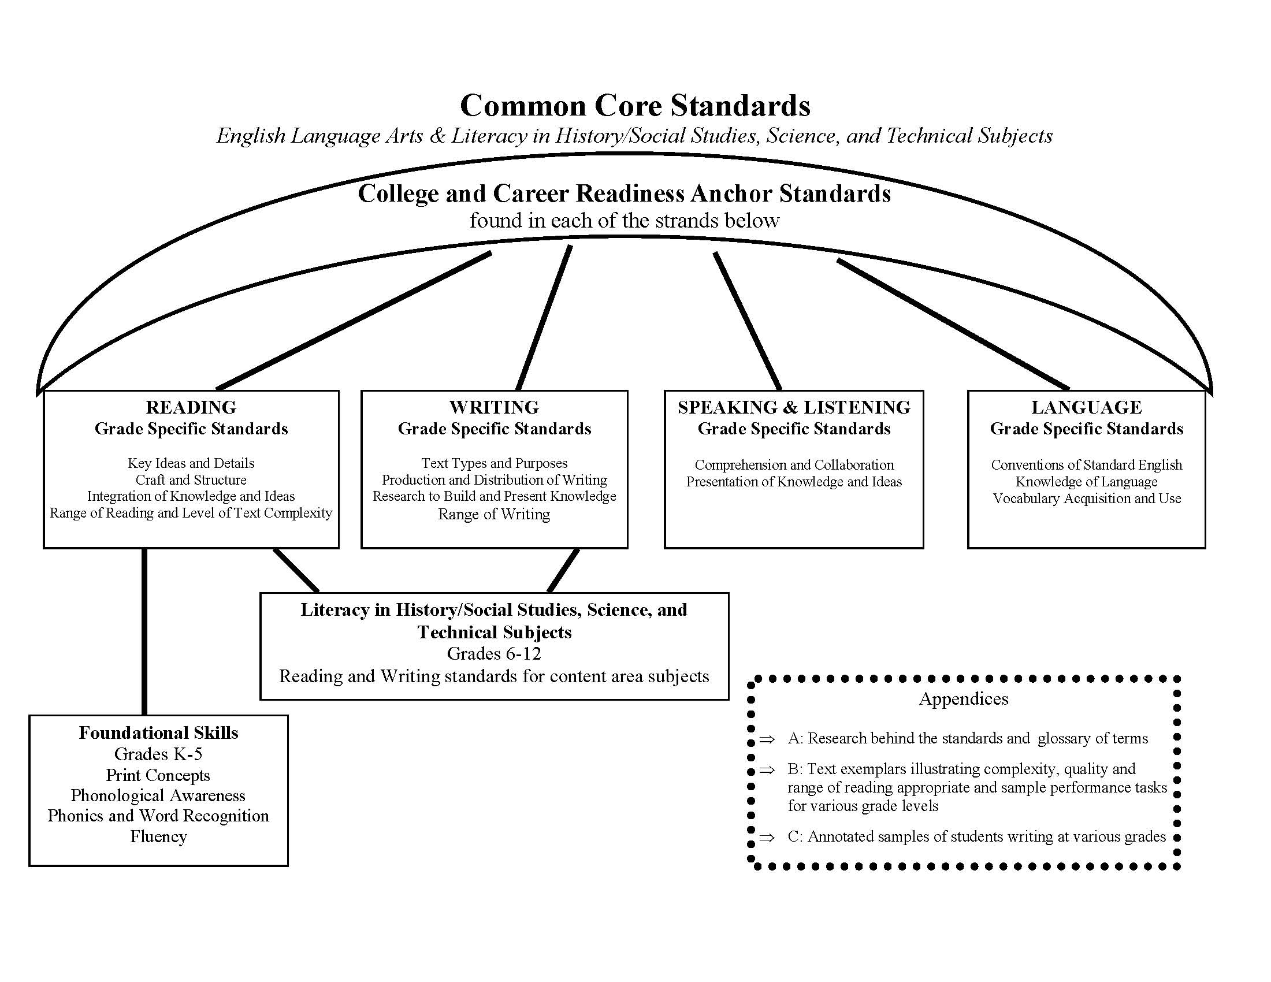

Slide 6
6 Shifts in English Language Arts Common Core
Balancing Informational and Literary Text
Building Knowledge in the Disciplines
Staircase of Text Complexity
Text-Dependent Questions, Text-Based Answers
Writing from Sources
Academic Vocabulary

Slide 7
Implications for the Shifts
Instruction
Assessment
Leadership

Slide 8
Shift 1: Balancing Informational and Literary Text K-5
Instructional Shift
Students should read a true balance of informational and literary texts.
Students access the world—science, social studies, the arts, literature—through text.

Slide 9
Shift 1: Balancing Informational and Literary Text K-5
Instructional Implications
Equal exposure of informational and literary texts
Increase exposure to informational texts
Explicitly teach students strategies for reading informational text
Build students’ background knowledge and content knowledge through text
Notes:
NAEP

Slide 10
Shift 1: Balancing Informational and Literary Text K-5
Assessment Implications
Students must assessed with a balance of authentic informational and literary texts to include texts from the domains of ELA, science, history/social studies, technical subjects, and the arts.
Both close, analytic reading as well as comparing and synthesizing ideas across texts should be expected.

Slide 11
Shift 1: Balancing Informational and Literary Text K-5
Implications for Leaders:
Ensure a students have access to a balance of literary and informational text in the classroom.
Look for both literary and informational text being used within the same unit.
Look for students engaging in reading then discussing and gathering evidence from informational text.

Slide 12
Shift 1: Balancing Informational and Literary Text K-5
Implications for Leaders:
Provide professional development and collaborative planning opportunities for teachers around the use of literary non-fiction and informational text.
Ensure student access to both informational as well as literary text.

Slide 13
Shift 2: Building Knowledge in the Disciplines 6-12
Instructional Shift
Literacy standards (6-12) are predicated on teachers in ELA, social studies, science and technical subjects using their content area expertise to help students meet the particular challenges of reading, writing, speaking, listening and language in their respective fields.

Slide 14
Shift 2: Building Knowledge in the Disciplines 6-12
Instructional Implications
All content area teachers teach literacy in their discipline
Build background knowledge to increase reading skills
Teach different strategies for different types of text
Explicitly teach students how to use text as source of evidence—topic and opinion writing
Teach use of primary and secondary sources

Slide 15
Shift 2: Building Knowledge in the Disciplines 6-12
Assessment Implications
Students must demonstrate literacy skills;
reading carefully and closely;
gathering evidence to support an explanation, summary, claim, or comparison about what is read;
compare and contrast information from primary and secondary sources
analyzing, integrating, and presenting the supporting evidence in writing
construct their understanding of a topic using multiple sources
Assessments will require critical thinking across texts, writing, and presentation.

Slide 16
Shift 2: Building Knowledge in the Disciplines 6-12
Implications for Leaders:
Ensure school-wide content-area literacy
Look for teachers building content knowledge through reading text and writing about what they read
Look for students applying literacy skills with content area texts; including primary and secondary documents

Slide 17
Shift 2: Building Knowledge in the Disciplines 6-12
Implications for Leaders:
Provide professional development and collaborative planning opportunities around disciplinary literacy.
Provide professional development for teaching of discipline-specific strategies vs. a generic list of strategies.
Look for students reading and writing
for multiple audiences and purposes
across disciplines.

Slide 18
Shift 3: Staircase of Text Complexity
Instructional Shift
K-12 emphasizes text complexity as the most important factor in developing skilled readers
CCSS ELA require a step of growth on the text complexity staircase
Instruction should be centered around appropriate text complexity with close reading

Slide 19
Shift 3: Staircase of Text Complexity
Instructional Implications
Ensure students are engaged in more complex texts at each grade level
K-2 exposure to complex text through read aloud
Students must engage in rigorous discussion around complex text
Give more time for reading
Allow students to productively struggle
Provide scaffolding
Notes:
Don’t frontload everything
Don’t be over-dependent on leveled text

Slide 20
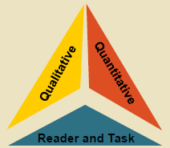
Text Complexity is Defined by:
Qualitative Measures:
levels of meaning, structure, language conventionality and clarity, and knowledge demands
Quantitative Measures: (Lexiles)
readability and other scores of text complexity (word length or frequency, sentence length, text cohesion)
Reader and Task:
background knowledge of reader, motivation, interests, and complexity generated by tasks assigned
Notes:
And here is what QUALITATIVE measures include:
Levels of meaning or purpose
Is it specifically stated/clear? Or are there inferences that need to be made by the reader?
Structure of Text
-Linear/nonlinear, one/multiple narrators, deviations from standard conventions of genre, number of plots
Language Conventionality and Clarity
-Literal, clear, or contemporary language vs. figurative, ambiguous, or unfamiliar language
Knowledge Demands
-Is understanding dependent on prior knowledge or open to any level?
Thinking about these four elements—how many people are confident that our students have a solid grasp on these qualitative elements?
So—this is probably a shift in expectation for many students.
QUANTITATIVE
Flesch-Kincaid Grade Level test –uses word length and sentence length
Dale-Chall Readability Formula and Lexile Framework for Reading- substitutes word frequency instead of word length
ATOS (Advantage-TASA (Touchstone Applied Science Associates) Open Standard) formula (used by Renaissance Learning—Accelerated Reader)- uses word length, sentence length, and text length.
CCSS does not endorse any particular quantitative measures. They only suggest using multiple measures to determine text complexity.
READER AND TASK
text are not the only considerations of what makes a text complex.
Effective comprehension involves an active reader.
Factors such as motivation (students are usually more motivated when the topic is of interest, and when there is some degree of student choice), knowledge (usually some connect to the text increases connection and comprehension), and the reservoir of personal experiences connected to the topic of the text are important to consider when selecting a text.
The purpose of the reading (assignment, enjoyment, learning etc.) also needs to be considered.
Thinking about the three components of text complexity—can you think about a recent text you’ve read or used in class—how would you rate its text complexity—why?

Slide 21
Text Complexity
Quantitative
measures difficulty
+
Qualitative
levels of meaning
+
Reader Task Components
reader motivation and prior knowledge

Slide 22
Shift 3: Staircase of Text Complexity
Assessment Implications
Passage and/or text selection for assessments should be based on appropriate text complexity guidelines for each grade level (CCSS Appendix A)
Students will be required to read closely and answer questions by citing evidence from text

Slide 23
Shift 3: Staircase of Text Complexity
Implications for Leaders:
Ensure teachers are increasing text complexity from grade-to-grade (R.CCR.10)
Review current grade level materials and resources to determine appropriate text complexity
Encourage and look for teachers allowing students to productively struggle with complex texts

Slide 24
Shift 3: Staircase of Text Complexity
Implications for Leaders:
Provide professional development and collaborative planning for teachers to learn appropriate scaffolding techniques for complex texts

Slide 25
Shift 4: Text-Dependent Questions Text-Based Answers
Instructional Shift
Teachers should train students to go back to the text to find evidence to and develop their ability to engage in rich, evidence-based dialogue about a text they have read
Teachers should design questions and tasks that require students to respond both orally and in writing to questions about a text in which the answers are found within the text and not based on prior knowledge, experience or opinion text.

Slide 26
Shift 4: Text-Dependent Questions Text-Based Answers
Instructional Implications
Create opportunities for students to have deep, evidence-based conversations about text
Teach students how to go back and find evidence in text
Ask and identify questions that are text-dependent
Have students read, reread, reference other texts, and dig deeply in order to answer questions

Slide 27
Shift 4: Text-Dependent Questions Text-Based Answers
Assessment Implications
Questions on assessments should require students to gather evidence from the text and not rely on memorization
Students should have opportunities to argue their beliefs around complex texts in assessments.
Students should be able to make evidentiary arguments both in conversation as well as writing citing evidence from text.

Slide 28
Shift 4: Text-Dependent Questions Text-Based Answers
Implications for Leaders:
Encourage teachers to spend more time teaching students how to revisit texts to find evidence and write stronger argument
Look for students who are responding to text-dependent questions based on evidence and findings from the text
Provide planning time for teachers to
craft appropriate text-dependent
questions and tasks

Slide 29
Shift 5: Writing From Sources
Instructional Shift
Writing needs to use evidence to inform or make an argument.
Less emphasis on personal narratives
Writing should respond to ideas, events, and facts read in texts.
Short, focused research projects K-12
Opinion/ Argument | Informative/ Explanatory | Narrative

Slide 30
Shift 5: Writing From Sources
Instructional Implications
Students should write from multiple sources about a single topic
Students should synthesize and analyze ideas and concepts to draw an opinion or conclusion
Teach text features and apply to writing
Develop reading, writing, speaking, listening through research projects
Use rubrics as an instructional tool

Slide 31
Shift 5: Writing From Sources
Assessment Implications
Students should engage in purposeful writing that requires text evidence to support reasoning and synthesis of information from multiple texts.
Students must write to sources rather than writing to de-contextualized expository prompts.
Assessments should include rigorous expectations for narrative writing, including accuracy and precision in writing in later grades.

Slide 32
Shift 5: Writing From Sources
Implications for Leaders:
Guide teachers to increase opportunities for students to write from sources and maintain focus on writing genres in CCSS.
Look for students synthesizing, analyzing and writing about information from multiple texts.
Look for student use of rubrics and writing exemplars as a tool for self-evaluating.

Slide 33
Shift 6: Academic Vocabulary
Instructional Shift
Students must acquire and apply academic vocabulary that crosses multiple content areas and is found in both informational and literary text.
Academic vocabulary development will facilitate access and comprehension of grade-level complex text.

Slide 34
Shift 6: Academic Vocabulary
Instructional Implications
Develop students ability to use and access words found in text that may slightly out of reach.
Explicitly teach strategies that can be transferred across content areas.
Discriminate the tiers of vocabulary, addressing Tier 2 as a priority coupled with domain specific words

Slide 35
Academic Vocabulary
Three Tiers of words
Tier 1: Words of everyday speech*
Tier 2: Academic Vocabulary:
informational texts; analyze, relative, vary, formulate, specify, and accumulate
technical texts; calibrate, itemize, periphery
literary texts; misfortune, dignified, faltered, unabashedly
Tier 3: Domain Specific
circumference, lava, aorta, autocratic

Slide 36
Shift 6: Academic Vocabulary
Assessment Shift
Students should be assessed directly on the meaning of key, common terms that occur frequently and regularly across various content-area texts; of which the definition is discerned from text.
Assessments should address academic vocabulary assessed indirectly based on comprehension of text and academic language that pervades complex texts.

Slide 37
Shift 6: Academic Vocabulary
Implications for Leaders:
Look for explicit, research-based vocabulary instruction in which students are being taught transferable strategies
Look at students reading a variety of texts often
Look for students discussing words in relation to previous knowledge, what they are reading, digital media and informational text.

Slide 38
Shift 6: Academic Vocabulary
Implications for Leaders:
Provide collaborative time for teachers to study and identify key academic vocabulary
Provide training to teachers on strategically choosing and teaching of Tier 2 and Tier 3 vocabulary

Slide 39
The ELA/Literacy Common Core State
Standards signify a need to change practice
in the areas of content, instruction and
assessment in order to prepare New Mexico
students to be college and career ready.
If teachers are to teach differently, then principals need to lead differently.
The importance of structures like teacher
teams, common planning time, as well as support from school leadership, are integral to a school’s ability to make significant shifts in their everyday classroom practice.

Slide 41
http://ped.state.nm.us/elc

Slide 42
5 Local Action Steps Supported by the NMELC
Evaluate the Systems
Identify Individual Needs for Professional Development
Target Individual Student Growth
Retool and Reteam
Assess technology and infrastructure
Notes:
Use the Priority Schools Reflection Tools for Math and Literacy.
Does each staff member have an individual professional development that concentrates on skills need to teach CCSS? Is there a clear articulation and understanding of Level I, Level II, Level III responsibilities?
The new accountability system holds schools accountable for targeting student growth. Does everyone on site understand how Tier I, Tier II, and Tier III instruction and tools differ? Based on your data and evaluation is your best math teacher in front of your lowest performing math students?
Based on the Systems evaluation in Step 1, consider what new tools, curriculum improvements and new teams you may have to invest in. TOOLS: The PARCC, or future assessment system is designed using Understanding by Design; this designed can also be sued by teachers in their own unit planning.
TEAMS: Develop a district/school level transition team or site "ELC“. Task this group to become experts on the mathematics and ELA/Literacy Frameworks (Do a close study). Develop site based leadership system that invests and empowers site leaders. Assign district personnel to attend NMELC webinars and PD trainings.
Have an ELC framework/site team at each site to help be the experts on site. Is there an IT team, or does it all fall on the shoulders of one person?
5. The PARCC will be computer based. The 23 states are in the process of doing multi-step technology evaluations. Identify your district contact person who will communicate with PED the current status and needs of local technology. What new personnel configurations might you have to consider? (i.e. technology team). Who will be the communications liason between PARCC and the school site?

Slide 43
Thank You!
Questions?
http://ped.state.nm.us/elc

